Slide 1
Data Structure
Course code: cs-201
Topic: Queue

Slide 2
Goals for today
To introduce :
Queues
Algorithms for insertion and deletion in queues
Circular queues
Double-ended queues (Deque)
Priority queues

Slide 3
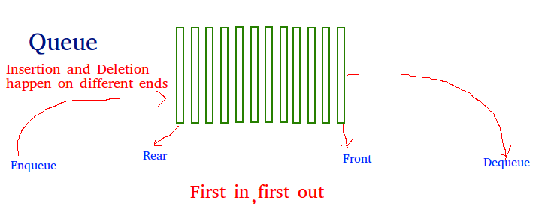
Queues
“A queue can be defined as an ordered list which enables insert operations to be performed at one end called REAR and delete operations to be performed at another end called FRONT.”
Queue is referred to be as First In First Out list (FIFO).

Slide 4
Queues
A queue is like a line of people waiting for a bank teller. The queue has a front and a rear.
$ $
Rear
Front

Slide 5
Queues
New people must enter the queue at the rear.
$ $
Front
Rear

Slide 6
Queues
When an item is taken from the queue, it always comes from the front.
$ $
Front
Rear

Slide 7
Some examples
Billing counter
Booking movie tickets
Queue for paying bills
A print queue
Vehicles on toll-tax bridge
Luggage checking machine

Slide 8
Application of Queue
Queue data structure are commonly used in computer operating systems.
They are especially important in multitasking environment, where several users or tasks may be required the same resource.
Communication software also uses queue to hold the data received over networks and dial-up connections.

Slide 9
Example
Printing, is controlled by a queue because only one document may be printed at a time.
A queue is used to hold print jobs submitted by the users, while the printer services those jobs one at a time.

Slide 10
Types of Queues in Data Structure
There are four different types of queues in data structures:
Simple Queue
Circular Queue
Priority Queue
Dequeue( Double ended Queue)

Slide 11

Simple Queue
It is the most basic queue in which the insertion of an item is done at the front of the queue and deletion takes place at the end of the queue.
It strictly follows the FIFO (First in First out) rule.

Slide 12
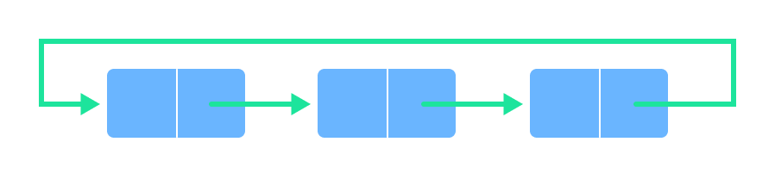
Circular Queue
In a circular queue, the last element points to the first element making a circular link.
The main advantage of a circular queue over a simple queue is better memory utilization. If the last position is full and the first position is empty, we can insert an element in the first position. This action is not possible in a simple queue.

Slide 13
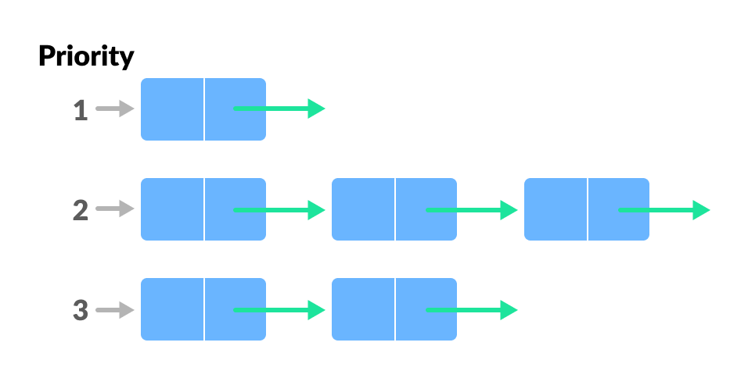
Priority Queue
A priority queue is a special type of queue in which each element is associated with a priority and is served according to its priority. If elements with the same priority occur, they are served according to their order in the queue.
Insertion occurs based on the arrival of the values and removal occurs based on priority.

Slide 14
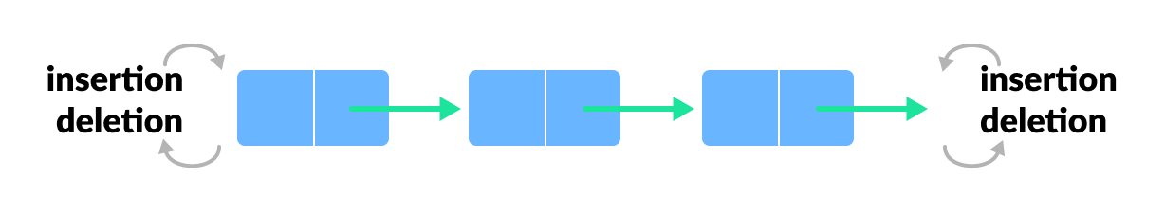
Deque (Double Ended Queue)
In a double ended queue, insertion and removal of elements can be performed from either from the front or rear. Thus, it does not follow the FIFO (First In First Out) rule.

Slide 15
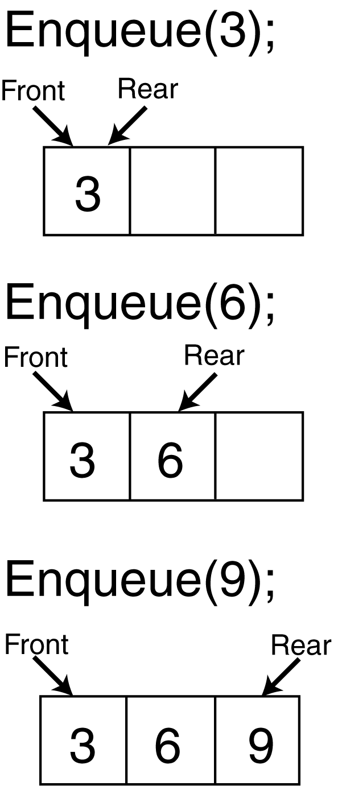
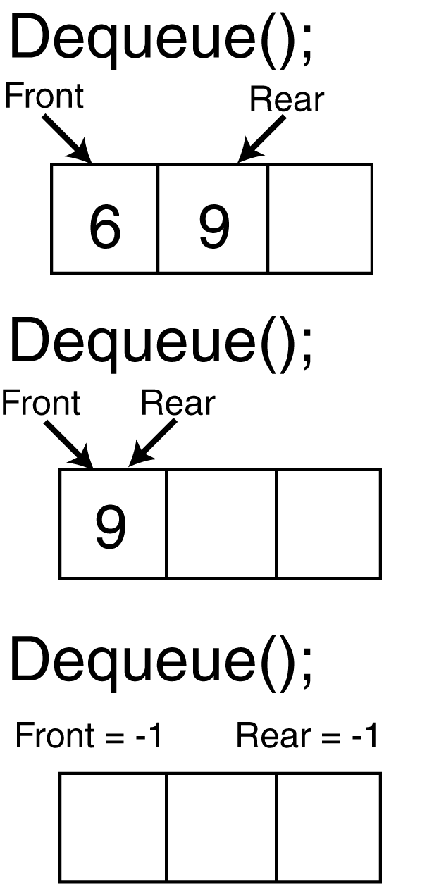
Common Operations (Queue ADT)

Slide 16
Implementation
Static
Queue is implemented by an array, and size of queue remains fix
Dynamic
A queue can be implemented as a linked list (or pointers), and expand or shrink with each enqueue or dequeue operation.

Slide 17
Common Operations (Queue ADT)
ENQUEUE(x,Q): Inserts element x at the rear/end of Queue Q.
DEQUEUE(Q): Deletes the element from the front of Q.
FRONT(Q): Returns the first element on Queue Q.
ISEMPTY(Q): Returns true if and only if Q is an empty queue (underflow).
ISFULL(Q) it checks if the queue is full (overflow)

Slide 18
Queue Implementation Using Array
We can easily represent queue by using linear arrays.
There are two variables i.e. front and rear, that are implemented in the case of every queue.
Front and rear variables point to the position from where insertions and deletions are performed in a queue.
Initially, the value of front and queue is -1 which represents an empty queue.

Slide 19
Alternative Array Implementation
Use two counters that signify rear and front
Front
When queue is empty both front and rear are set to -1
While enqueueing increment rear by 1, and while dequeueing increment front by 1
When there is only one value in the Queue, both rear and front have same index
First Element
Second Element
.
.
Rear
Last Element
maxlength

Slide 20
Array implementation of queues
0 1 2 3 4 5 6 7
myQueue:
17
23
97
44
front = 0
rear = 3
To insert: put new element in location 4, and set rear to 4
To delete: take element from location 0, and set front to 1

Slide 21
Array implementation of queues
front = 0
rear = 3
Initial queue:
17
23
97
44
After insertion:
17
23
97
44
333
After deletion:
23
97
44
333
front = 1
rear = 4

Slide 22
Alternative Array Implementation
Array Implementation
5
4
6
7
8
7
6
0 1 2 3 4 5 6 7 8
Front=0
Rear=6
8
7
6
0 1 2 3 4 5 6 7 8
Front=4
Rear=6
7
6
12
67
0 1 2 3 4 5 6 7 8
Front=5
Rear=8

Slide 23
Overflow and underflow condition in linear queues
If (rear=n) OR rear=ARRAY_SIZE-1 then print overflow
‘n’ represents the size of array
If (front=-1 AND rear=-1) then print underflow

Slide 24
Whenever an element is deleted from queue
Front=front+1
Whenever an element is inserted into queue
rear=rear+1

Slide 25
Enqueue Operation
Following are the steps to enqueue (insert) data into a queue
Check whether the queue is full or not.
If the queue is full – print the overflow error and exit the program.
If the queue is not full – increment the rear pointer to point to the next empty space.
Add the element in the position pointed to by the Rear.
Return success.

Slide 26
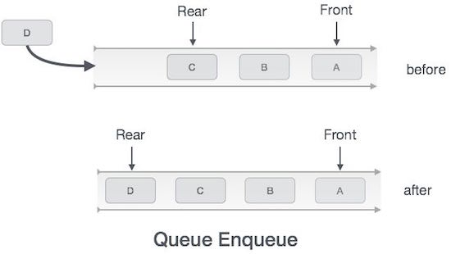
Algorithm for Enqueue Operation
procedure enqueue(data)
if queue is full
return “overflow”
endif
rear = rear + 1
queue[rear] = data
return true
end procedure

Slide 27
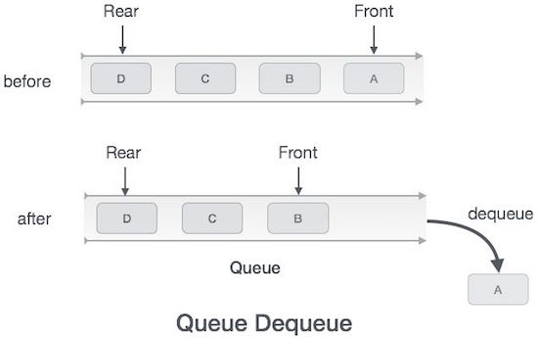
Dequeue Operation
Following are the steps to perform dequeue operation
Check whether the queue is full or not.
If the queue is empty – print the underflow error and exit the program.
If the queue is not empty – access the data where the front is pointing.
Increment front pointer to point to the next available data element.
Return success.

Slide 28
Algorithm for Dequeue Operation
procedure dequeue
if queue is empty
return “underflow”
end if
data = queue[front]
front = front + 1
return true
end procedure

Slide 29
Activity
Maintain a linear array QUEUE with N=5 memory locations. Observe that queue always occupies consecutive locations. Perform the following operations on initially empty queue.
Front :0 Rear 0
Enqueue A, B and C.
Dequeue A
Enqueue D and then E
Dequeue B and C
1 | 2 | 3 | 4 | 5

Slide 30
Algorithm for Enqueue using Link list
Here ‘front’ and ‘rear’ are like start and last node of linked list
If (front=rear=-1)
node *newnode = new node;
newnode->data=item;
front=rear=newnode;
Else
node *newnode=new node;
newnode->data=item;
newnode->link=-1;
rear->link=newnode;
rear = newnode;

Slide 31
Algorithm for Dequeue using Link list
Struct node *temp
Temp = front
if(front==0 && rear==0)
underflow
else
Print: front->data
front=front->link;
Free(temp)

